Slide 1
2022 UPDATED
PATRIOTIC
GOURMET AND COCKTAIL COLLECTION
HARD CANDY SPOONS
PRODUCT SELECTION & PRICING
Presented by
Phone: 206-365-4124
Fax: 206-365-0651
www.market2marketllc.com
Product selection will not change in 2023 There may be price changes.

Slide 2
PATRIOTIC PRODUCTS

Slide 3
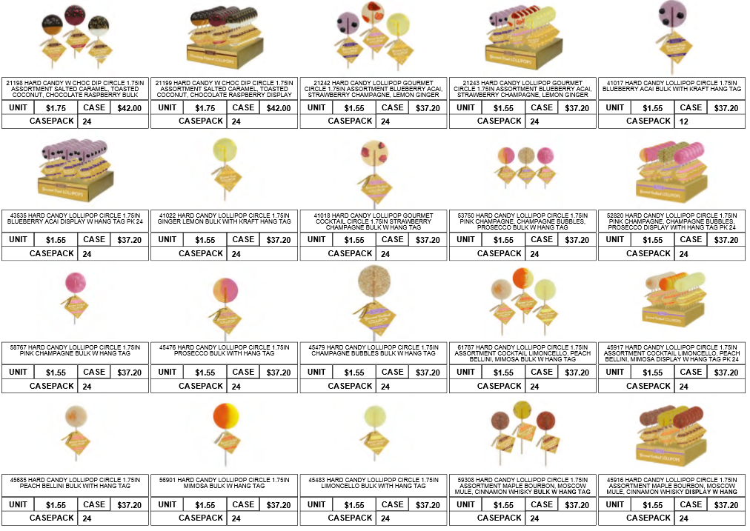
GOURMET & COCKTAIL PRODUCTS

Slide 4
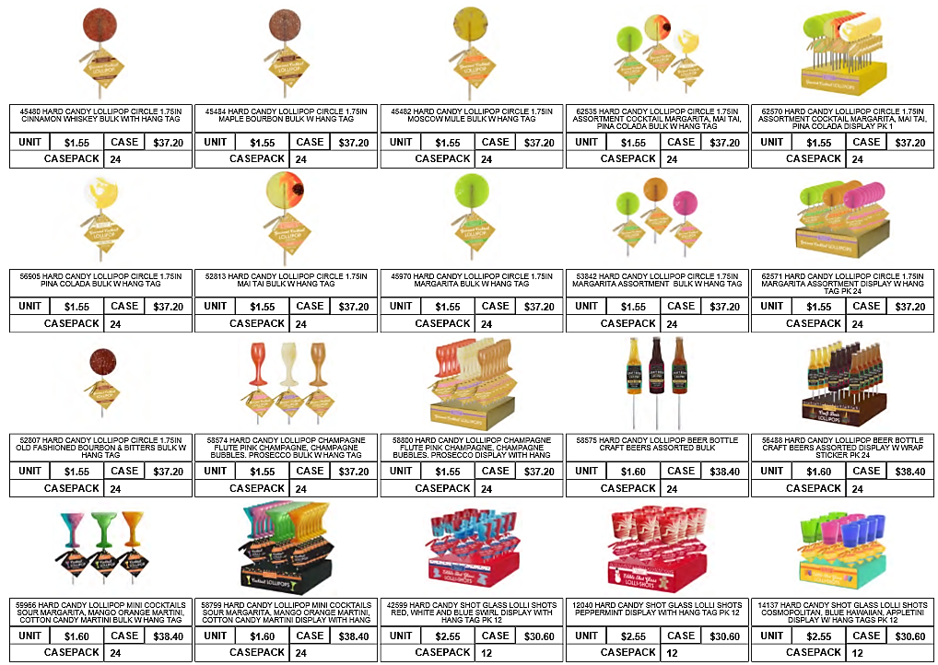
GOURMET & COCKTAIL PRODUCTS

Slide 5
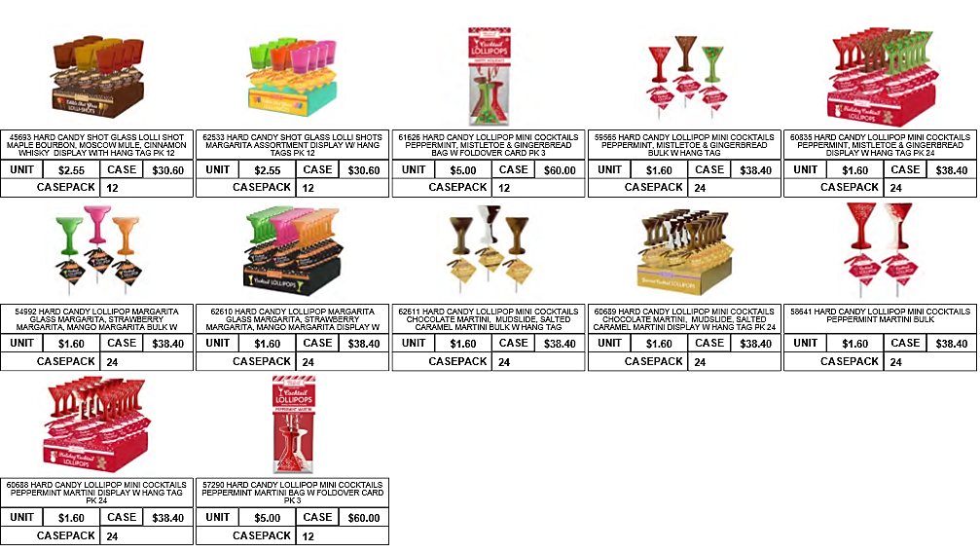
GOURMET & COCKTAIL PRODUCTS

Slide 6
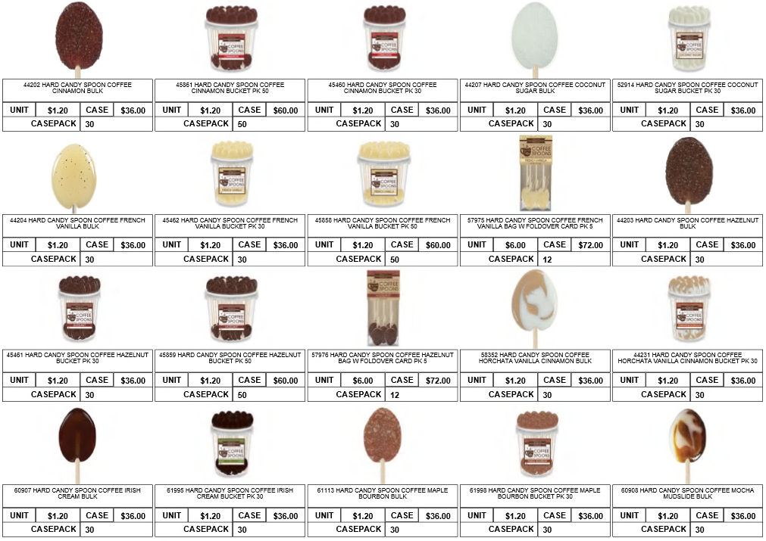
HARD CANDY SPOONS

Slide 7
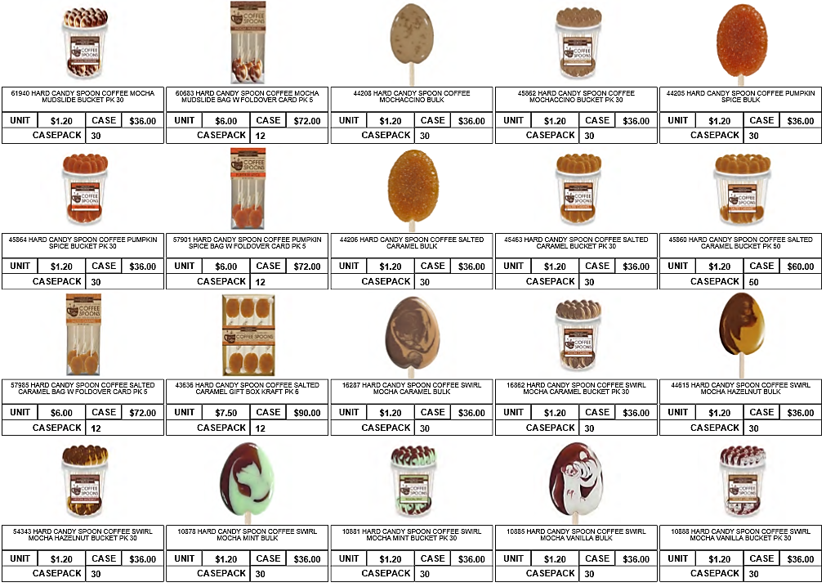
HARD CANDY SPOONS

Slide 8
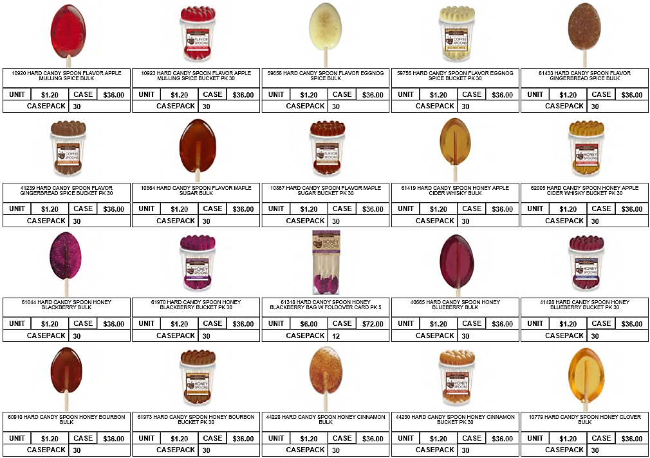
HARD CANDY SPOONS

Slide 9
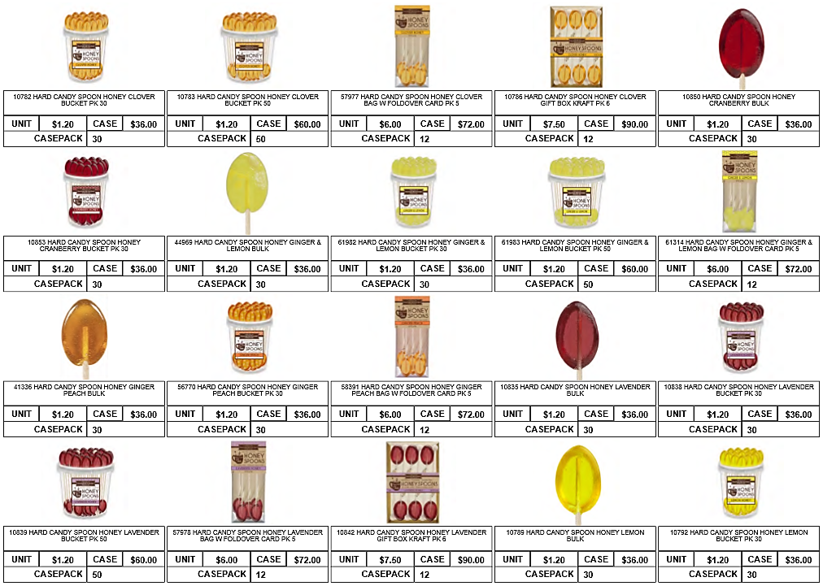
HARD CANDY SPOONS

Slide 10
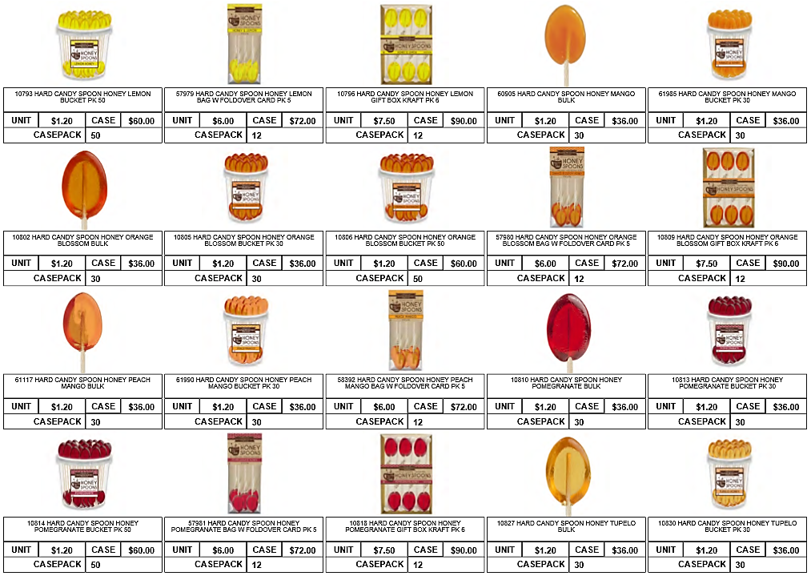
HARD CANDY SPOONS

Slide 11
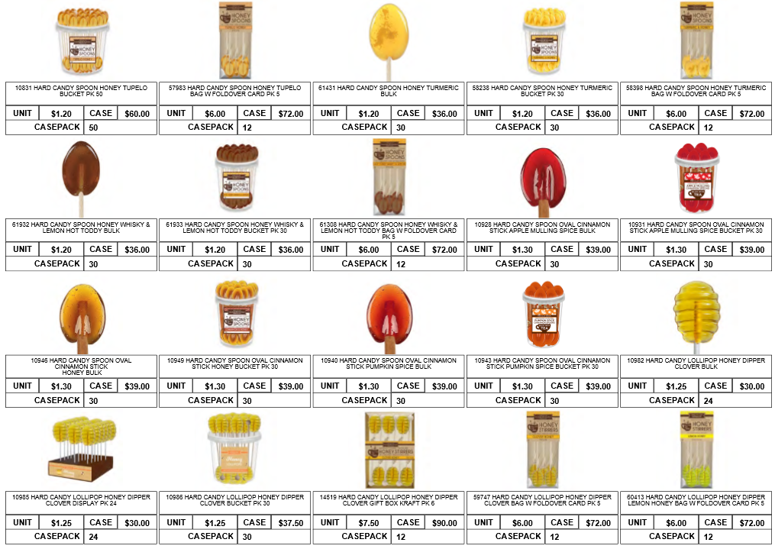
HARD CANDY SPOONS

Slide 12
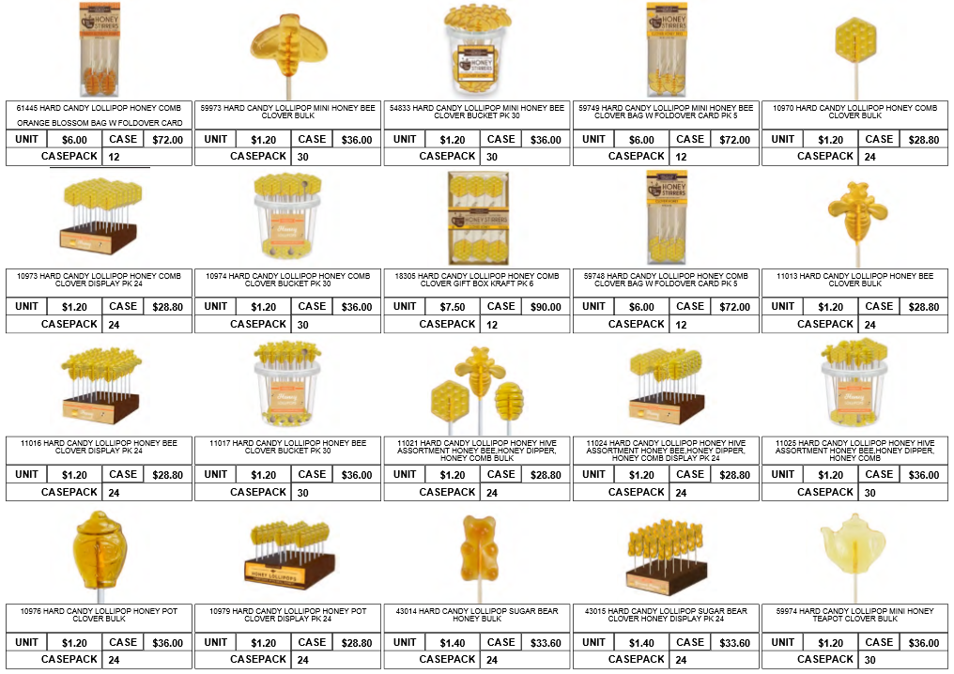
HARD CANDY SPOONS

Slide 13
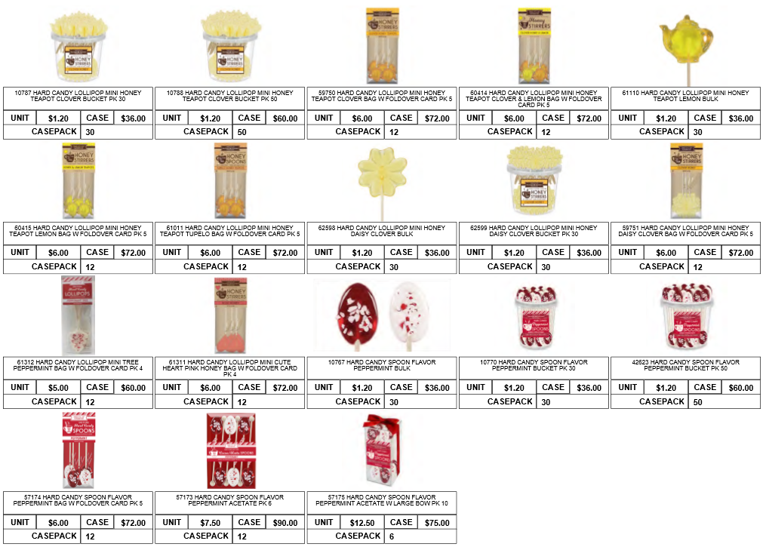
HARD CANDY SPOONS

